Slide 1



s
e
c
o
n
d
C
O
R
N
A
N
I
T
H
I
S
2.1-17
A free CD of this message will be available following the service
It will also be available for podcast later this week at calvaryokc.com

Slide 2
“God Shouldn't Have Called You” – Bruce Larsen
“There are many reasons why God shouldn't have called you. But don't worry. You're in good company.
Moses stuttered. David's armor didn't fit. John Mark was rejected by Paul.
Timothy had ulcers. Hosea's wife was a prostitute. Amos’ only training was in the school of fig-tree pruning.
Jacob was a liar.
David had an affair.
Solomon was too rich. Abraham was too old. David was too young.
O
A
N
S
2.1-17
I
I
s
e
c
o
n
d
C
R
N
T
H

Slide 3

“God Shouldn't Have Called You” – Bruce Larsen
Peter was afraid of death.
Lazarus was dead.
John was self-righteous. Naomi was a widow. Paul was a murderer.
So was Moses.
Jonah ran from God.
Miriam was a gossip. Gideon and Thomas both doubted.
Jeremiah was depressed and suicidal. Elijah was burned out. John the Baptist was a loudmouth.
O
A
N
S
2.1-17
I
I
s
e
c
o
n
d
C
R
N
T
H

Slide 4
“God Shouldn't Have Called You” – Bruce Larsen
Martha was a worry-wart.
Mary was lazy.
Samson had long hair.
Noah got drunk.
Did I mention that Moses had a short fuse?
So did Peter, Paul – well lots of folks did.
But God doesn't require a job interview. He doesn't hire and fire like most bosses.
O
A
N
S
2.1-17
I
I
s
e
c
o
n
d
C
R
N
T
H

Slide 5
“God Shouldn't Have Called You” – Bruce Larsen
He's not prejudiced or partial, not grudging, sassy, or brassy, not deaf to our cry, not blind to our need.
Satan says, “You're not worthy.”
Jesus says, “So what? I AM.”
Satan looks back and sees our mistakes.
God looks back and sees the cross. Sure, there are lots of reasons why God shouldn't have called us.
O
A
N
S
2.1-17
I
I
s
e
c
o
n
d
C
R
N
T
H

Slide 6
“God Shouldn't Have Called You” – Bruce Larsen
But if we are in love with Him; if we hunger for Him more than our next breath; He'll use us in spite of who we are, where we've been, or what we look like.
I pray that as Christians, we will step out of our limitations into the illimitable nature of who God is. Then our passion for God and our passion to communicate Him will make short work of our limitations.”
O
A
N
S
2.1-17
I
I
s
e
c
o
n
d
C
R
N
T
H

Slide 7
O
A
N
S
2.1-17
I
I
s
e
c
o
n
d
C
R
N
T
H

Slide 8
a priori – Made before or without examination; not supported by factual study.
O
A
N
S
2.1-17
I
I
s
e
c
o
n
d
C
R
N
T
H

Slide 9
O
A
N
S
2.1-17
I
I
s
e
c
o
n
d
C
R
N
T
H

Slide 10


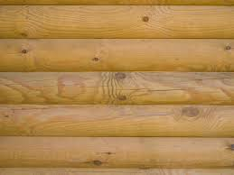
Arrives in Corinth and begins church (Acts 18.1)
Writes 1st letter from Ephesus (now lost) (1 Cor. 5.9)
Writes "sorrowful" letter (now lost) from Ephesus (2 Cor. 2.3)
Writes 1 Corinthians
AD 51
AD 52
AD 53
AD 54
AD 55
AD 56
Leaves Corinth for Ephesus (Acts 18.18)
1st letter being misunderstood, church sends delegation to Paul w/ specific questions (1 Cor. 16.17)
Makes “hasty” visit (2 Cor. 2.1)
Writes 2 Corinthians
O
A
N
S
2.1-17
I
I
s
e
c
o
n
d
C
R
N
T
H

Slide 11
John Trapp (1601-1669) – “St. Paul’s Epistles were written rather with tears than with ink.”
O
A
N
S
2.1-17
I
I
s
e
c
o
n
d
C
R
N
T
H

Slide 12
O
A
N
S
2.1-17
I
I
s
e
c
o
n
d
C
R
N
T
H

Slide 13
NLT (v. 5) – I am not overstating it when I say that the man who caused all the trouble hurt all of you more than he hurt me.
1 Cor. 5.5 – deliver such a one to Satan for the destruction of the flesh, that his spirit may be saved in the day of the Lord Jesus.
O
A
N
S
2.1-17
I
I
s
e
c
o
n
d
C
R
N
T
H

Slide 14
O
A
N
S
2.1-17
I
I
s
e
c
o
n
d
C
R
N
T
H

Slide 15
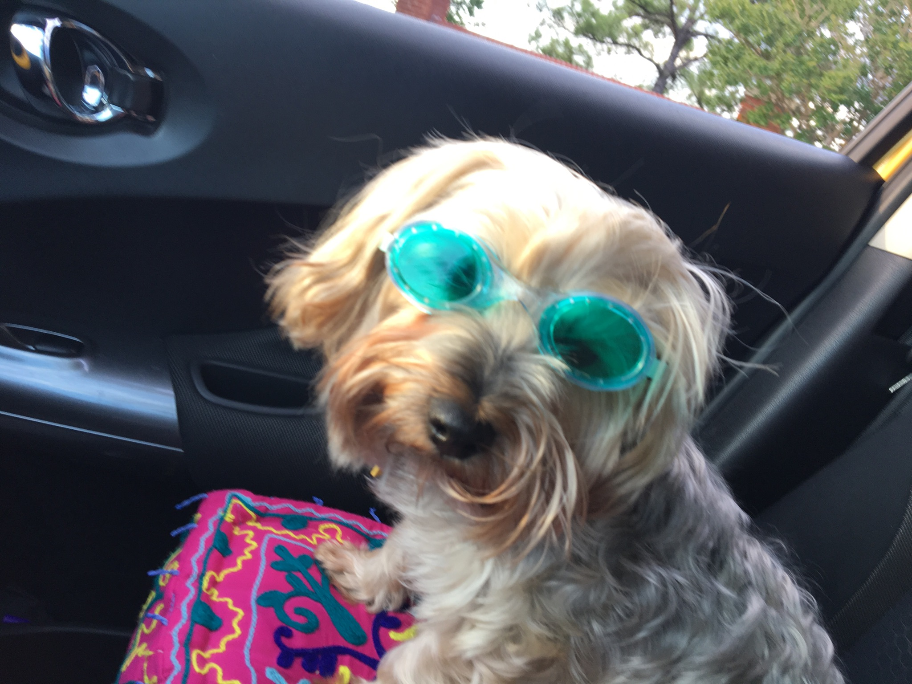
O
A
N
S
2.1-17
I
I
s
e
c
o
n
d
C
R
N
T
H

Slide 16
O
A
N
S
2.1-17
I
I
s
e
c
o
n
d
C
R
N
T
H

Slide 17
Matt. 5:14-15 – ¹⁴ For if you forgive men their trespasses, your heavenly Father will also forgive you. ¹⁵ But if you do not forgive men their trespasses, neither will your Father forgive your trespasses.
O
A
N
S
2.1-17
I
I
s
e
c
o
n
d
C
R
N
T
H

Slide 18
O
A
N
S
2.1-17
I
I
s
e
c
o
n
d
C
R
N
T
H

Slide 19
fragrance (v. 14) – osmē
to put forth an odor (whether good or bad)
fragrance (v. 15) – euodìa
eu – good
ozō – stink
O
A
N
S
2.1-17
I
I
s
e
c
o
n
d
C
R
N
T
H

Slide 20
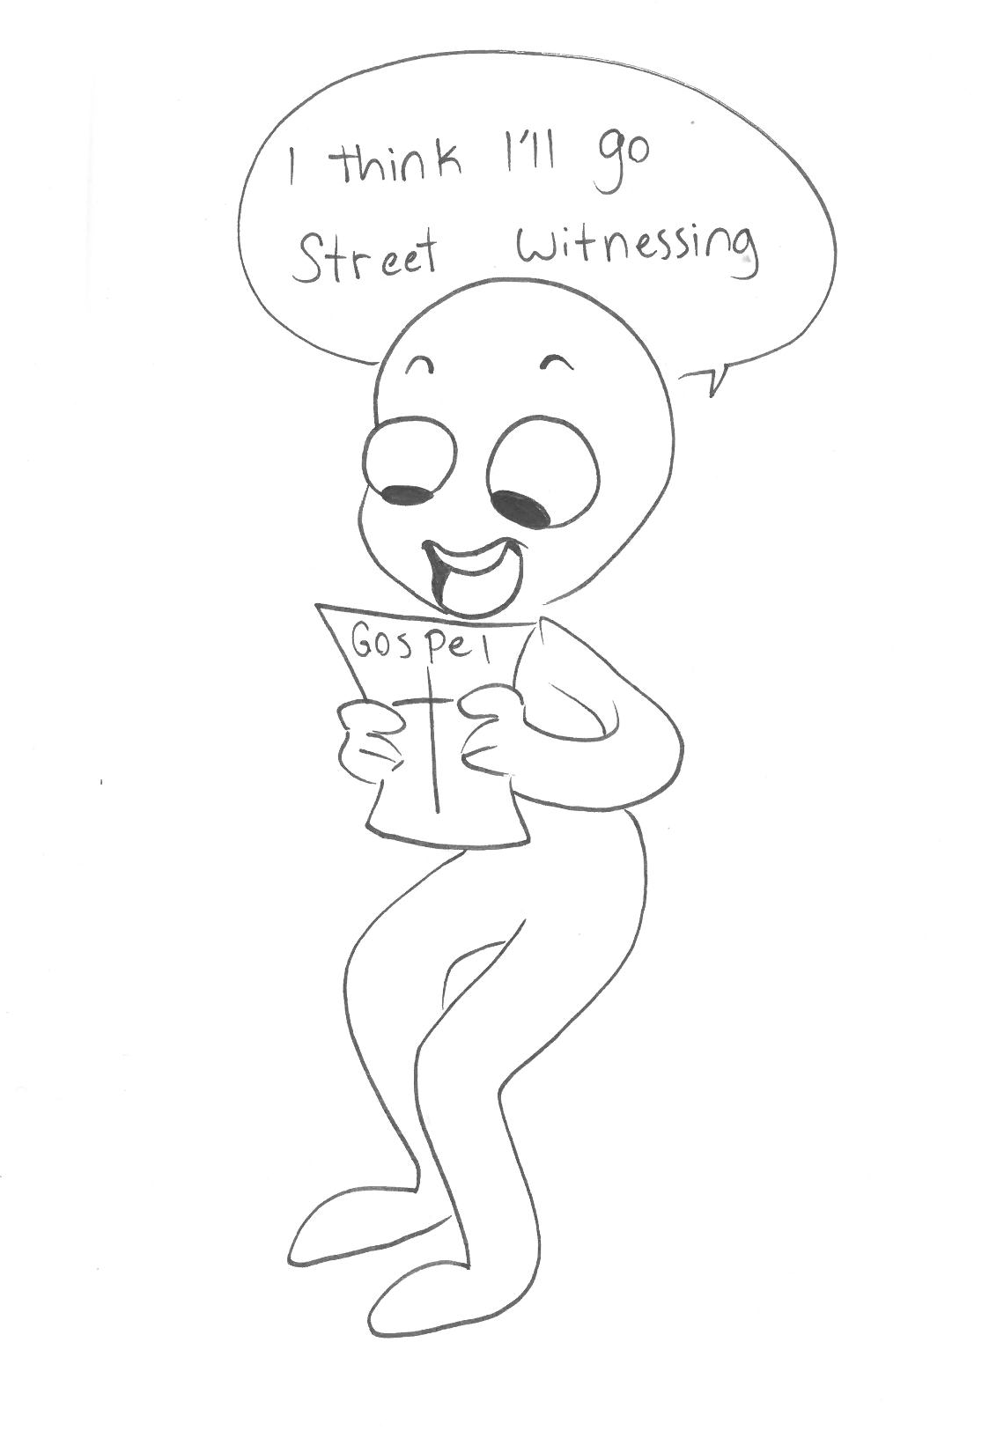
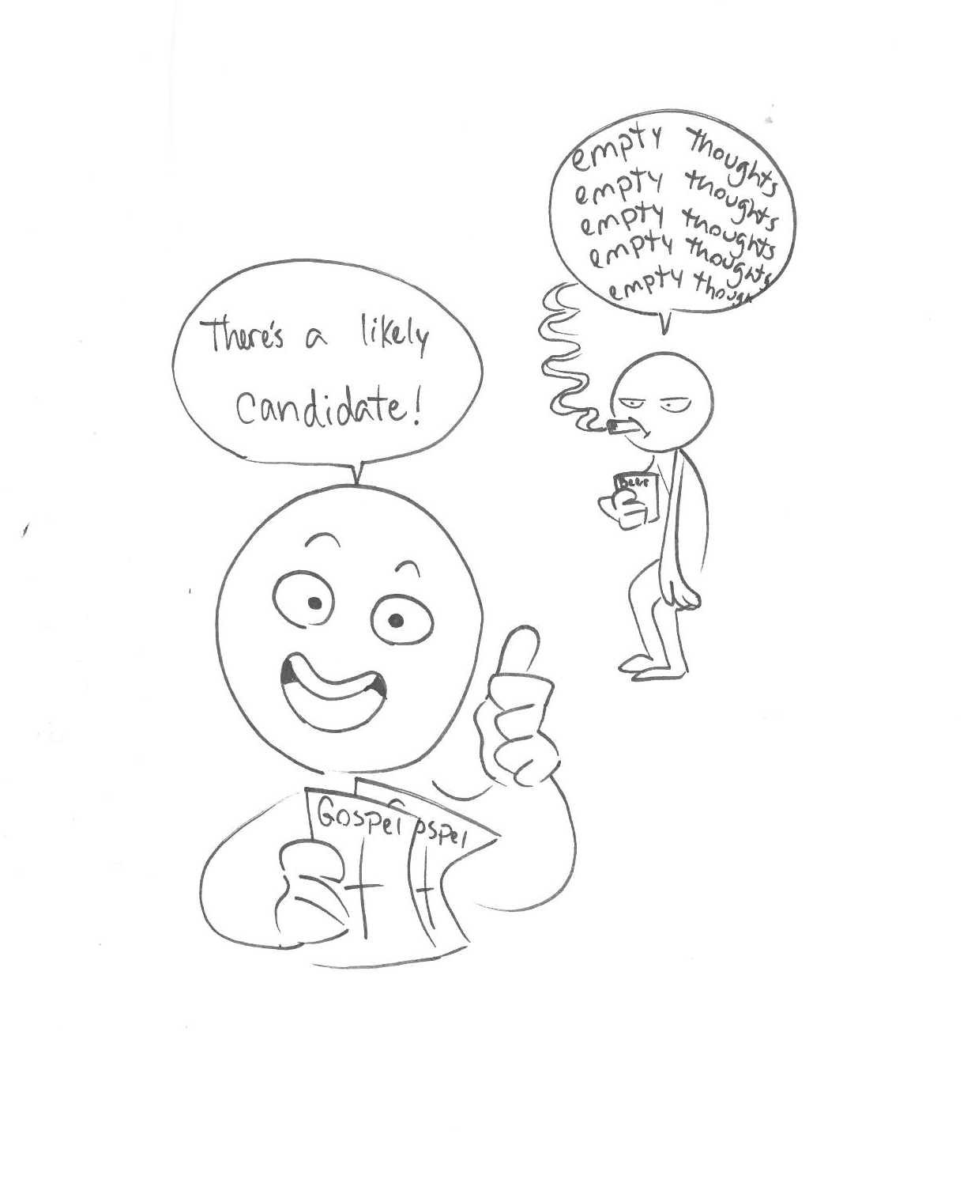
artwork by gabi thompson
O
A
N
S
2.1-17
I
I
s
e
c
o
n
d
C
R
N
T
H

Slide 21
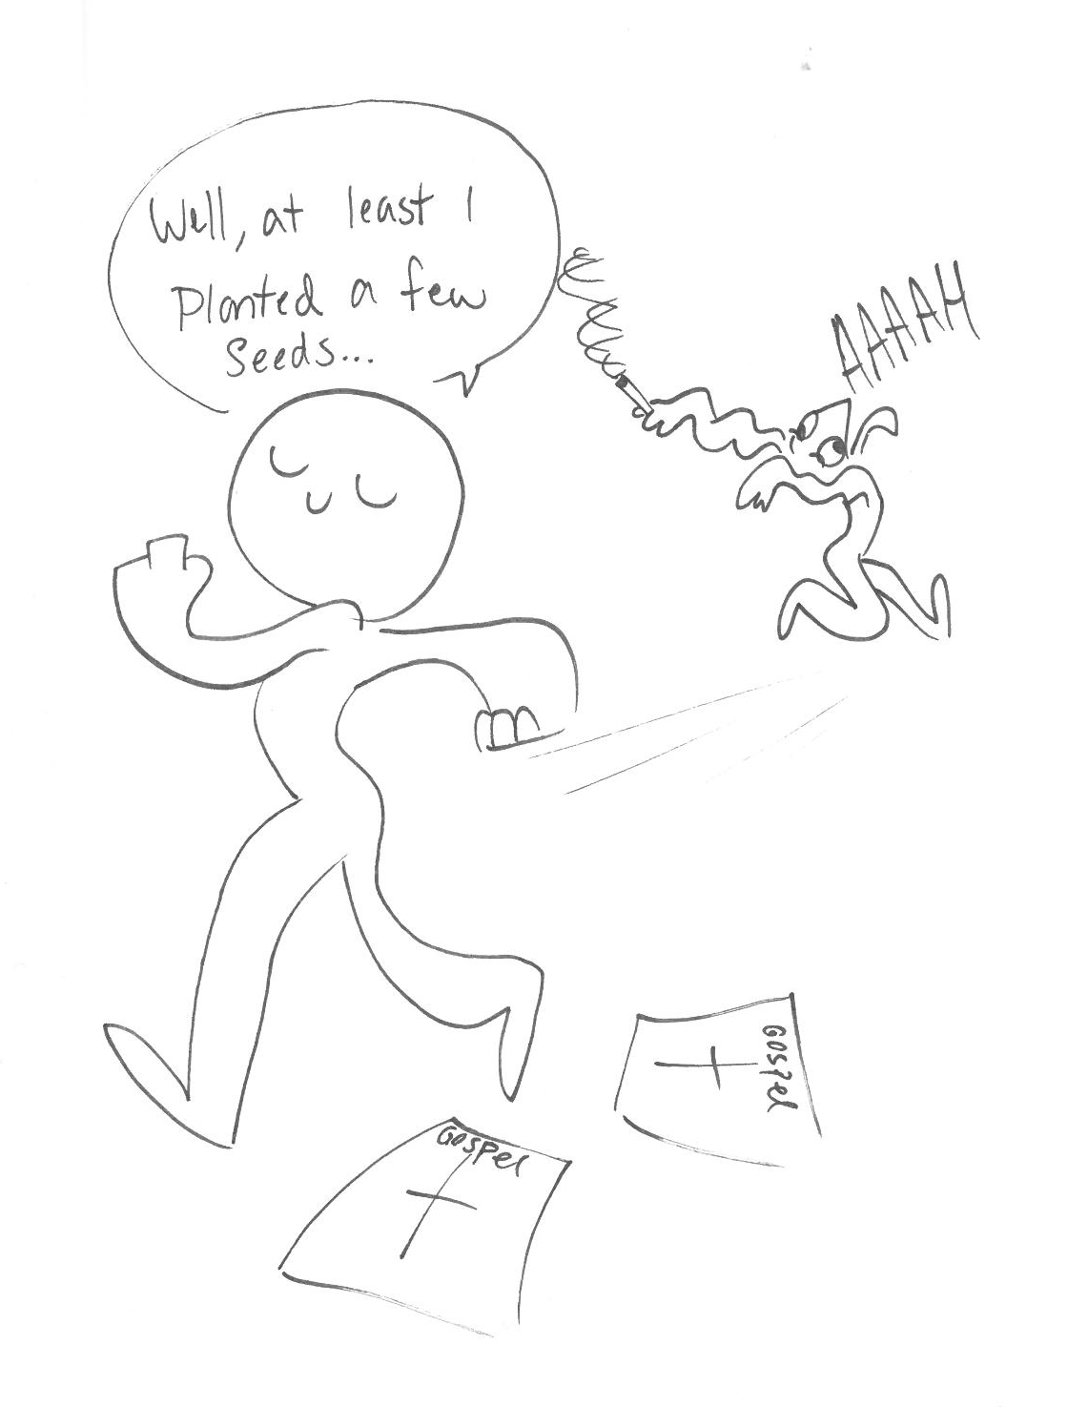
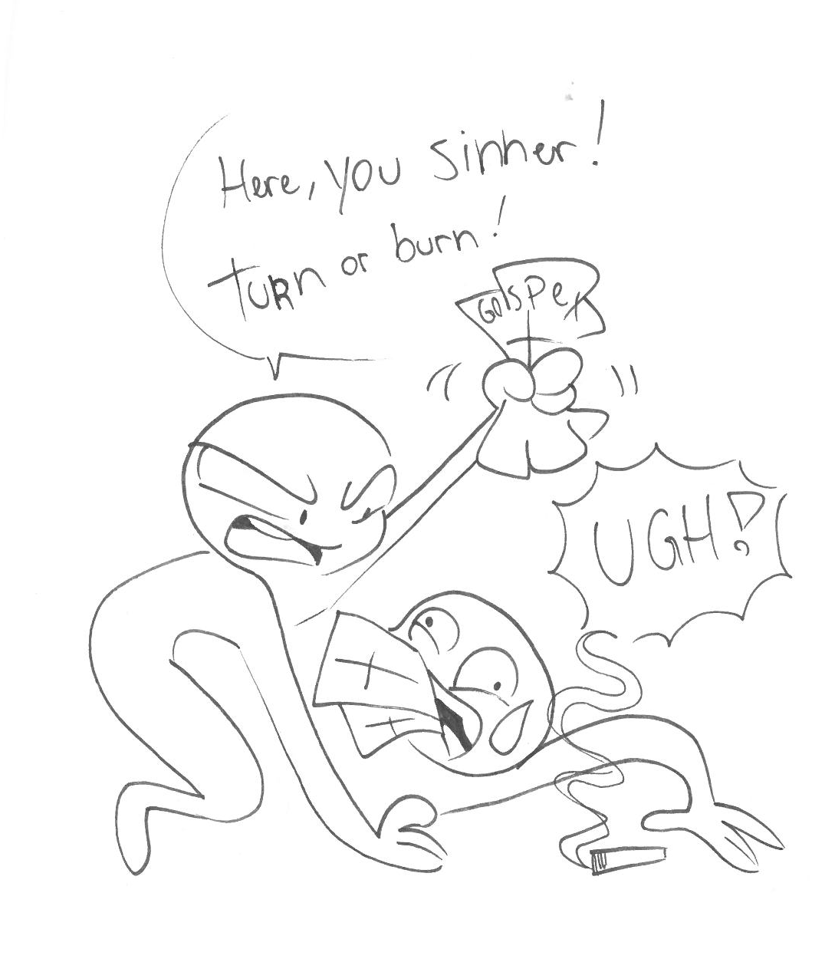
artwork by gabi thompson
O
A
N
S
2.1-17
I
I
s
e
c
o
n
d
C
R
N
T
H

Slide 22
O
A
N
S
2.1-17
I
I
s
e
c
o
n
d
C
R
N
T
H

Slide 23



O
A
N
S
2.1-17
I
I
s
e
c
o
n
d
C
R
N
T
H

